Slide 1
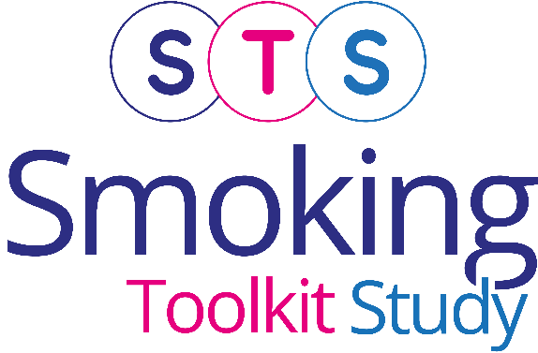


Annual findings 2025 on smoking in England from the Smoking Toolkit Study
Vera Buss
Robert West
Dimitra Kale
Loren Kock
Jamie Brown
Last updated: 15th January 2026
www.smokinginengland.info
jamie.brown@ucl.ac.uk

Slide 2
Cigarette smoking prevalence
Base: Adults (16 and over till Feb 20; 18 and over from April 20; 16 and over from Jan 22)
Graph shows prevalence estimate and upper and lower 95% confidence intervals

Slide 3
Cigarette smoking prevalence in adults by region (2007-2025)
Base: Adults (16 and over till Feb 20; 18 and over from April 20; 16 and over from Jan 22)

Slide 4
Stopped smoking in past 12 months by region (2007-2025)
Base: Past-year smokers (16 and over till Feb 20; 18 and over from April 20; 16 and over from Jan 22)

Slide 5
Tried to stop smoking in past year by region (2007-2025)
Base: Past-year smokers (16 and over till Feb 20; 18 and over from April 20; 16 and over from Jan 22)

Slide 6
Proportion of cigarette smokers who use hand-rolled cigarettes
Base: Adults (16 and over till Feb 20; 18 and over from April 20; 16 and over from Jan 22)
Graph shows prevalence estimate and upper and lower 95% confidence intervals

Slide 7
Proportion of cigarette smokers who are non-daily smokers
Base: Adults (16 and over till Feb 20; 18 and over from April 20; 16 and over from Jan 22)
Graph shows prevalence estimate and upper and lower 95% confidence intervals

Slide 8
Daily cigarette consumption by social grade
Base: Adults who smoked in the past year
ABC1: Professional to clerical occupation C2DE: Manual occupation

Slide 9
Daily cigarette consumption by age
Base: Adults who smoked in the past year

Slide 10
Daily cigarette consumption by gender
Base: Adults who smoked in the past year

Slide 11
Weekly spend on cigarettes among smokers by social grade
Base: Adults who smoked in the past year
ABC1: Professional to clerical occupation C2DE: Manual occupation

Slide 12
Weekly spend on cigarettes among smokers by age
Base: Adults who smoked in the past year

Slide 13
Weekly spend on cigarettes among smokers by gender
Base: Adults who smoked in the past year

Slide 14
Methods
Monthly household surveys of representative samples of 1700-1800 adults (16+ years old) in England
  Due to the pandemic, from April 2020 to December 2021 surveys conducted by telephone (rather than face-to-face) and among adults aged 18 and over. From January 2022 data collection resumed among those aged 16 and over.
  Between November 2020 and February 2022, ~0.8% of cases in England were incorrectly weighted 0. This has now been updated and some point estimates over this period have changed slightly (typically 1 d.p.) compared with earlier versions.
  From April 2020 (switch to telephone), Ipsos started recording ~<5% cases as missing for social grade. To derive weight variable (which uses social grade), Ipsos assumed missing = social grade C1. To ensure analyses using weight and social grade reflect target weighed profile, social grade was recoded to reflect this assumption. Different assumptions for missing social grade cases were explored in a parallel telephone and face-to-face (with no missing social grade) wave, and this assumption found least distorting.
Fieldwork by TNS/BMRB 2006 up to April 2013, then IPSOS MORI
Sample weighted to match population in England on key socio-demographics
Further details: www.smokinginengland.info

