Slide 1
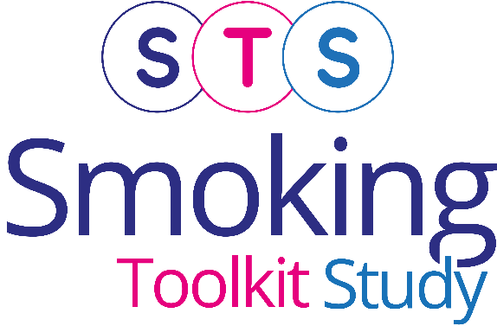


Monthly trends on smoking in England from the Smoking Toolkit Study
Vera Buss
Robert West
Loren Kock
Dimitra Kale
Jamie Brown
Last updated: 11th March 2026
www.smokinginengland.info
jamie.brown@ucl.ac.uk

Slide 2
Prevalence of cigarette smoking by social grade
Latest 3-month moving averages
13.7%
7.3%
12.5%
16.9%
16.9%
AB: Higher or intermediate managerial, administrative and professional;
C1: Supervisory, clerical and junior managerial, administrative and professional; C2: Skilled manual workers;
D: Semi-skilled and unskilled manual workers; E: State pensioners, casual and lowest grade workers, unemployed with state benefits

Slide 3
Prevalence of cigarette smoking by age
Latest 3-month moving averages
13.7%
17.4%
12.1%
Age groups: 16 to 34 years; 35 years and over

Slide 4
Prevalence of cigarette smoking by gender
Latest 3-month moving averages
13.7%
14.2%
12.9%

Slide 5
Attempts to stop by social grade
ABC1: Professional to clerical occupation; C2DE: Manual occupation

Slide 6
Support used in quit attempts
NRT OTC: Nicotine replacement therapy bought over the counter; Med Rx: Prescription medication.
Method is coded hierarchically with smokers using more than one method classified into most intensive by the following scheme:
1. Nothing, 2. NRT OTC, 3. Vape, 4. Med Rx, 5. Stop Smoking Service. In updates until June 2015, NRT OTC was coded above
vape - earlier figures have now been revised. See vaping tracking slides for any use of different treatments.

Slide 7
Common triggers for past-year quit attempts
Question: Which of the following do you think contributed to you making the most recent quit attempt?

Slide 8
Less common triggers for past-year quit attempts
Govt advert: Government TV\radio\press advert; NRP: nicotine replacement product.
Question: Which of the following do you think contributed to you making the most recent quit attempt?

Slide 9
GP-triggered quit attempts

Slide 10
Motivation to quit
ABC1: Professional to clerical occupation; C2DE: Manual occupation

Slide 11
Harm reduction
NRT: Nicotine replacement therapy

Slide 12
Methods
Data collected during monthly household survey
Each month involves a new representative sample of ~1700 adults (16 and over)
Due to the pandemic:
  The March 2020 survey did not complete face-to-face collection at short notice and is missing
  To present trends, March is interpolated as the average of Feb and April
  From April 2020 to December 2021, surveys were conducted by telephone and among adults aged 18 and over. From January 2022 data collection resumed among those aged 16 and over.
  Between November 2020 and February 2022, ~0.8% of cases in England were incorrectly weighted 0. This has now been updated and some point estimates over this period have changed slightly (typically 1 d.p.) compared with earlier versions.
  From April 2020 (switch to telephone), Ipsos started recording ~<5% cases as missing for social grade. To derive weight variable (which uses social grade), Ipsos assumed missing = social grade C1. To ensure analyses using weight and social grade reflect target weighed profile, social grade was recoded to reflect this assumption. Different assumptions for missing social grade cases were explored in a parallel telephone and face-to-face (with no missing social grade) wave, and this assumption found least distorting.
Running since November 2006 and has accumulated more than 300,000 respondents of whom more than 65,000 are ‘last-year smokers’
Fidler, et al., 2011. 'The smoking toolkit study': a national study of smoking and smoking cessation in England. BMC Public Health 11:479
For more info see www.smokinginengland.info

